Slide 1
Escape the resistance

Slide 2
Antibiotic Resistance
Notes:
Kijken of pakkendere plaatjes/nieuwsartikelen

Slide 3
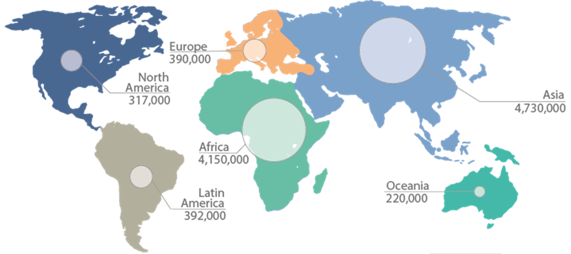
Antibiotic resistance in 2050
Adapted from Sugden R, et al., "Challenging antimicrobial resistance globally." Nature Microbiology (2016)

Slide 4
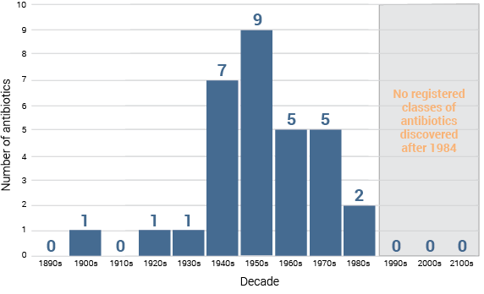
Discovery void of antibiotics
Adapted from Lynn L. Sylver, "Challenges of Antibacterial Discovery." Clinical Microbiology Review (2011)
Notes:
Tekst leesbaarheid grafiek vergroten

Slide 5
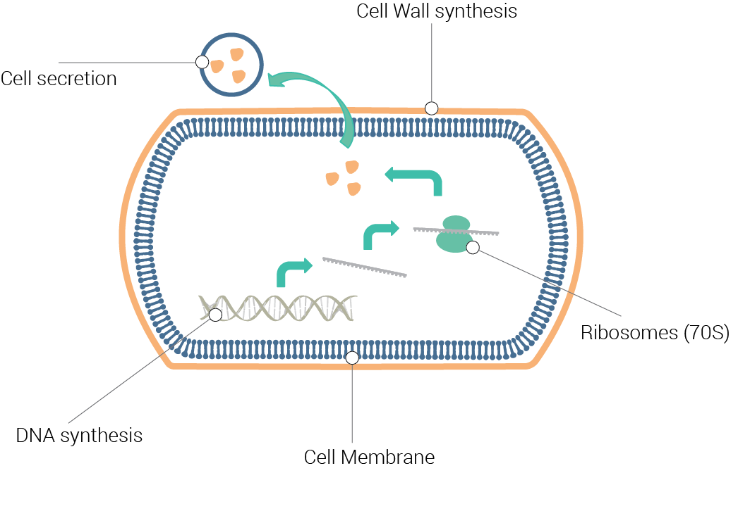
Antibiotics targets
Notes:
One lethal antibiotic is hard to find, and easier for bacteria to become resistant to
Strong because specific target, but because specific, also easy for bacteria to become resistant

Slide 6
Speed of Antibiotic Resistance
Links to: https://www.youtube.com/watch?v=plVk4NVIUh8
Notes:
https://www.youtube.com/watch?v=plVk4NVIUh8

Slide 7
Only use antibiotics when prescribed by a doctor
Complete your antibiotic treatment
Slowing antibiotic resistance
Limit your animal product consumption
Take preventive measures against infections

Slide 8
Not all bacteria are harmful
Microbiota
help you digest
Bacteria
produce for us, such as Insulin
Bacteria are
vital for Earths ecosystems

Slide 9
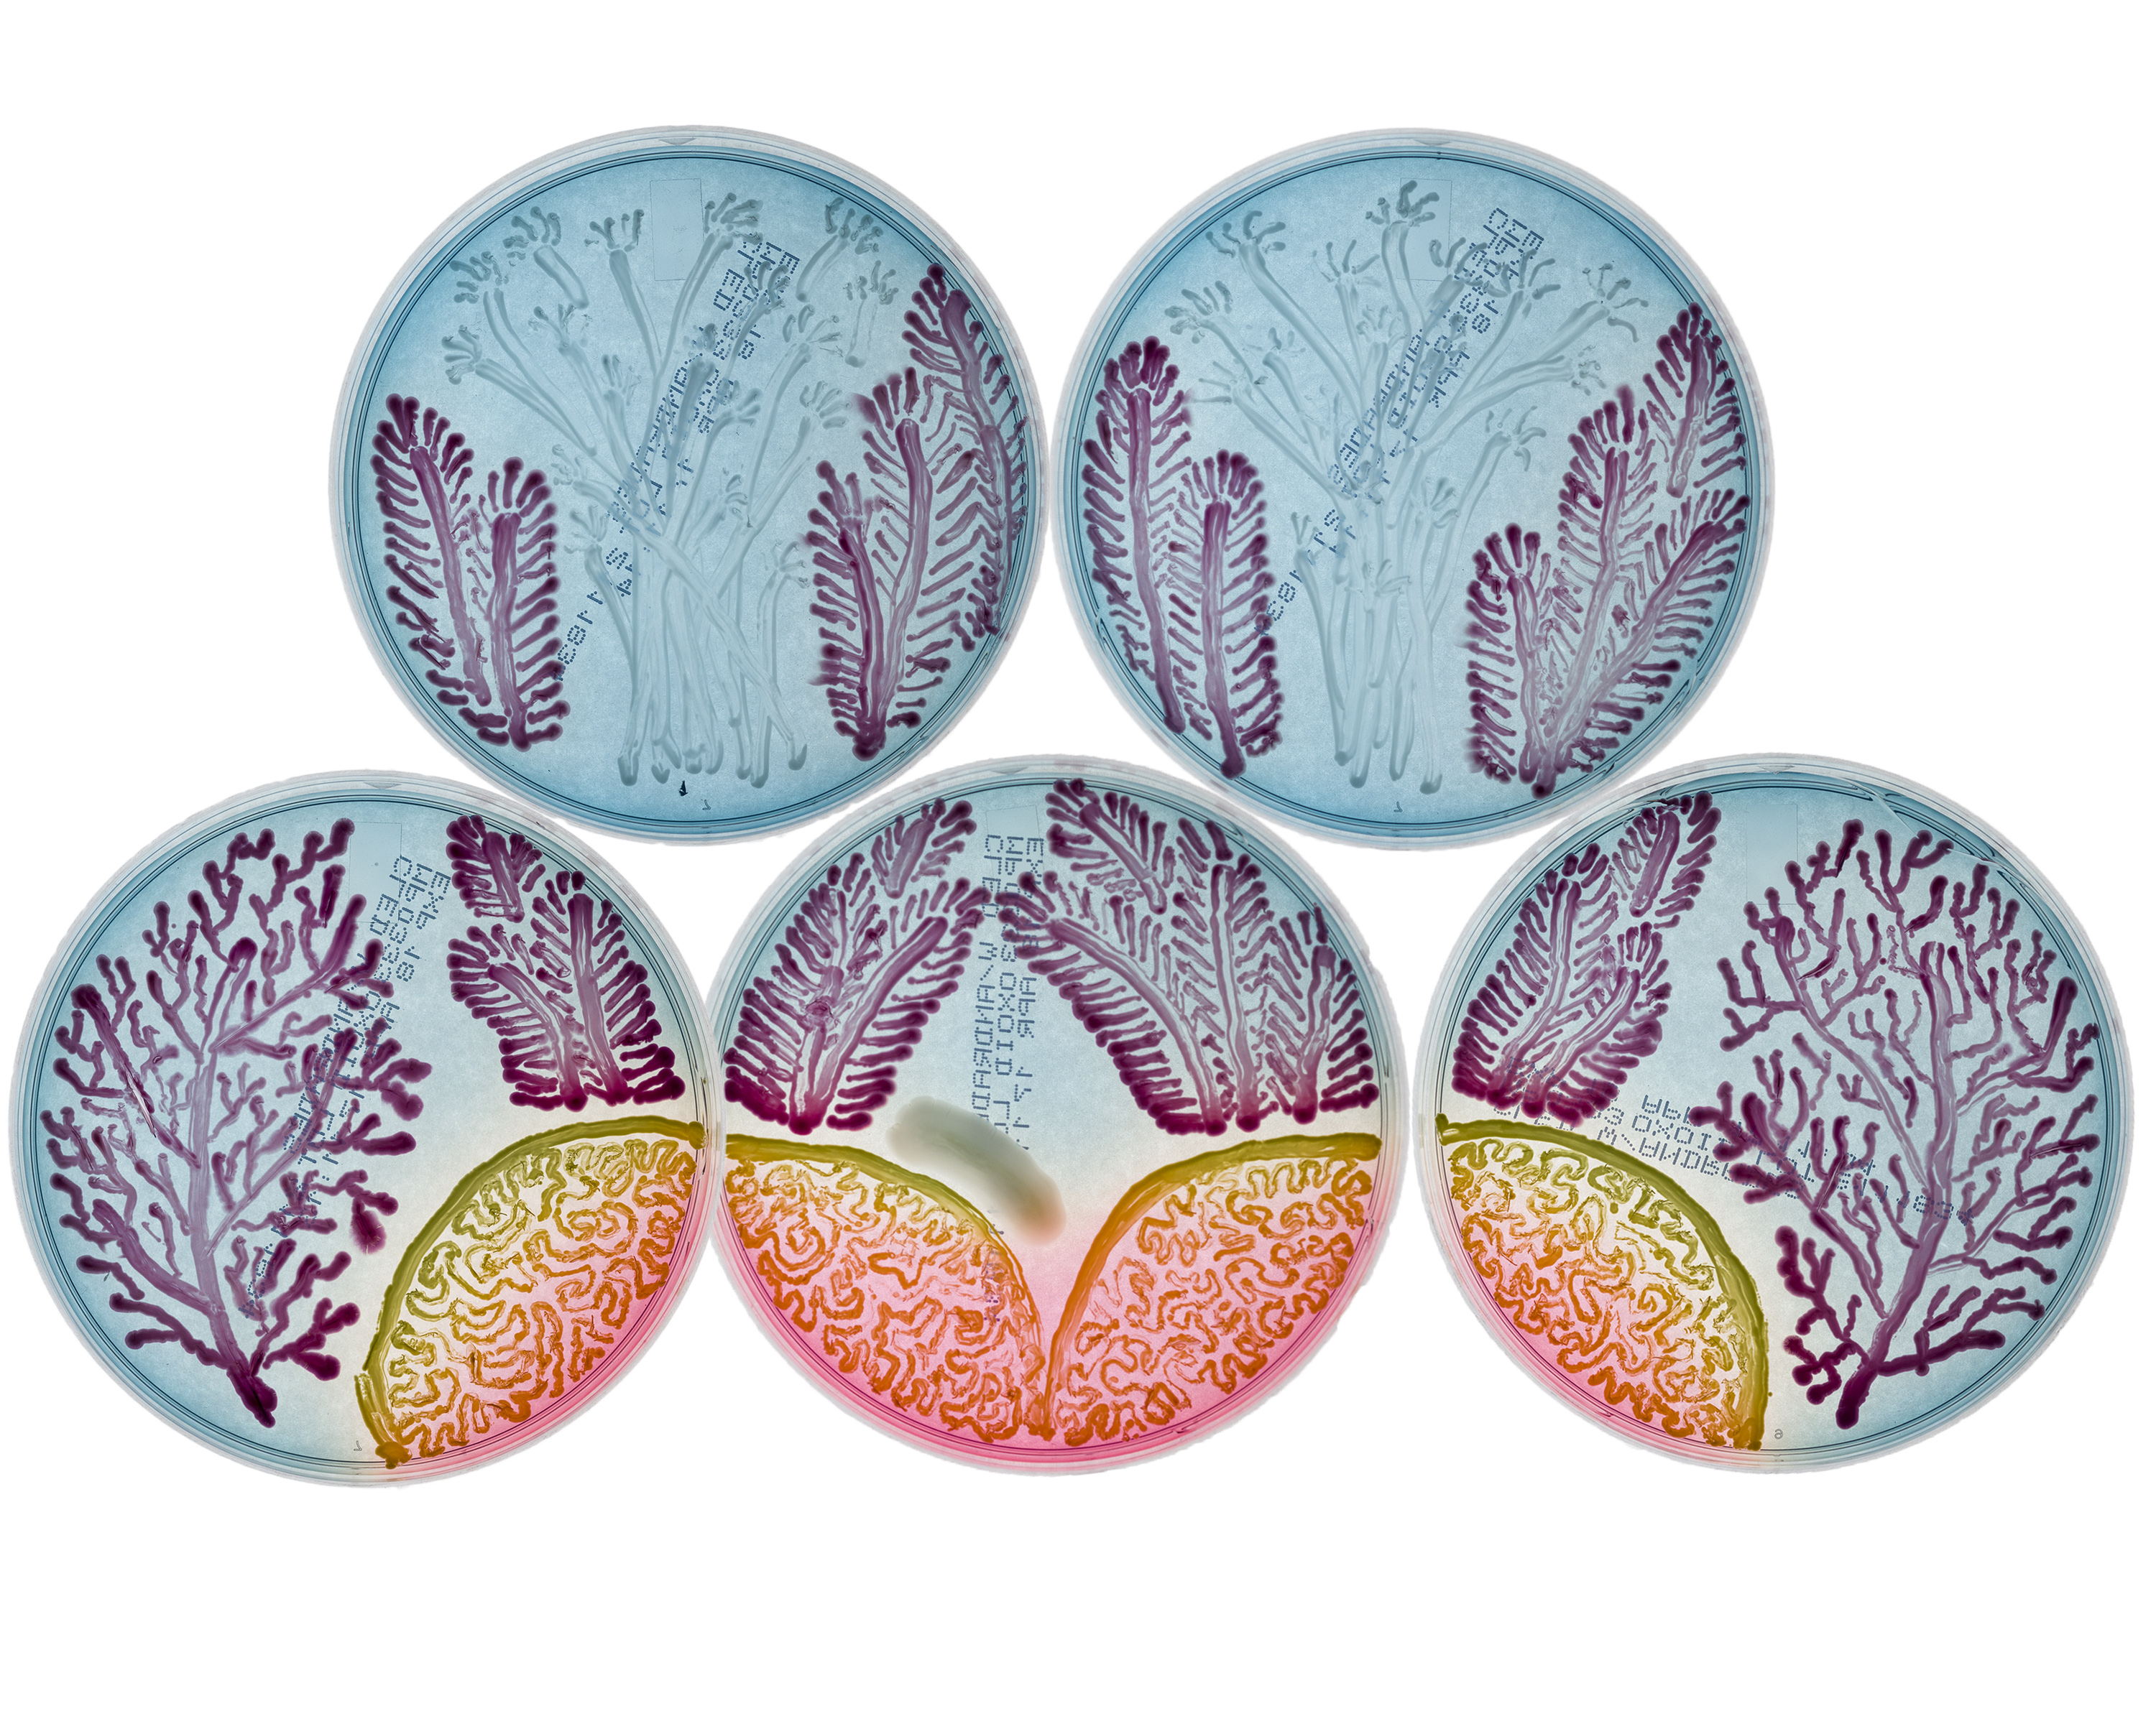
Agar art

